Slide 1
WRITING THE PAST
The Theory and Method of History
SPLASH 2018
Matthew Yarnall

Slide 2
INTRODUCTION

Slide 3
History is what the present chooses to remember about the past.
-Carl Becker

Slide 4
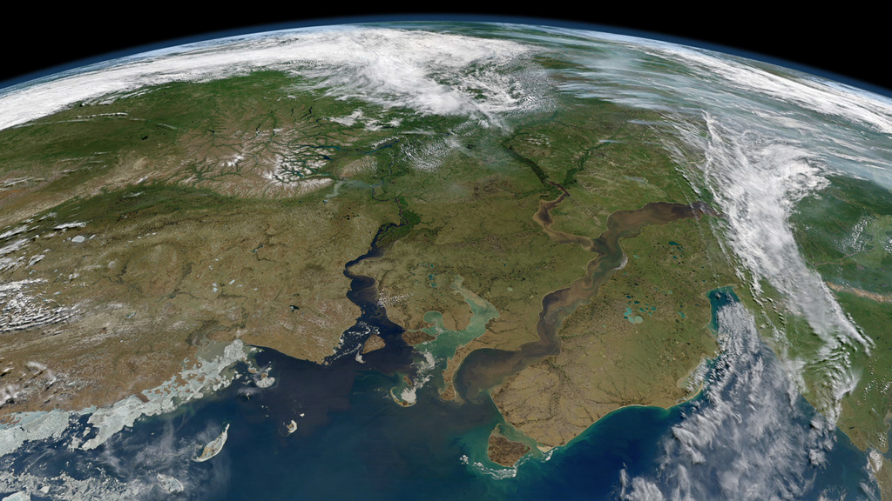
History is what the present chooses to remember about the past.
-Carl Becker

Slide 5
Behind the features of landscape, behind tools of machinery, behind what appear to be the most formalized written documents, and behind institutions, which seem almost entirely detached from their founders, there are men, and it is men history seeks to grasp.
-Marc Bolch

Slide 6
AUTOPIOGRAPHICAL MYTHMAKIG

Slide 7
[Autobiographical Mythmaking] helps to preserve a sense of psychological coherence and personal integrity over time.
-Barbara Myerhoff

Slide 8
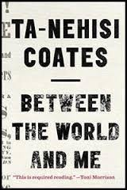

Slide 9
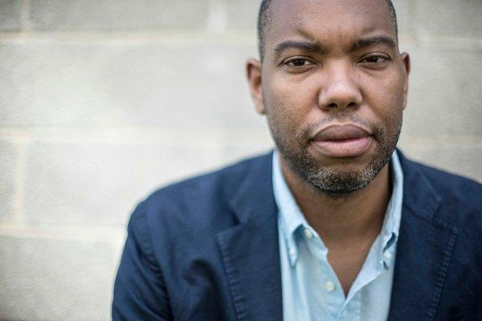
There the boy stood, with the gun brandished, which he slowly untucked…and in his small eyes I saw a surging rage that could, in an instant, erase my body….I remember being amazed that death could so easily rise up from the nothing of a boyish afternoon…

Slide 10
…I came to understand that my country was a galaxy, and this galaxy stretched from the pandemonium of West Baltimore to the happy hunting grounds of Mr. Belvedere….I felt, but did not yet understand, the relation between that other world and me.
-Ta-Nehisi Coates

Slide 11
In reviewing the personally experienced past from a more remote point in time, we inadvertently mythologize it. The process of constantly reworking one’s own experienced past…obviously does violence to the original experience.
-Paul Cohen

Slide 12


Slide 13
History is what the present chooses to remember about the past.
-Carl Becker

Slide 14
PROBLEMS WITH PRIMARY SOURSES

Slide 15
1) Minimal Source Record

Slide 16
2) Cognitive Dissonance

Slide 17
3) Narrative Epistemology

Slide 18
Narrative structure pervades our very experience of time and social existence, independently of our contemplating the past as historians.
-David Car

Slide 19
CONCLUTION

Slide 20
[The Historian’s Craft] entails a complex set of negotiations between present and past, incorporating something of vital importance from transforming along the way, the consciousness that each brings to the table from the outset.
-Paul Cohen

Slide 21
[The Historian’s Craft] entails a complex set of negotiations between present and past, incorporating something of vital importance from transforming along the way, the consciousness that each brings to the table from the outset.
-Paul Cohen

Slide 22
THANK YOU

